Slide 1
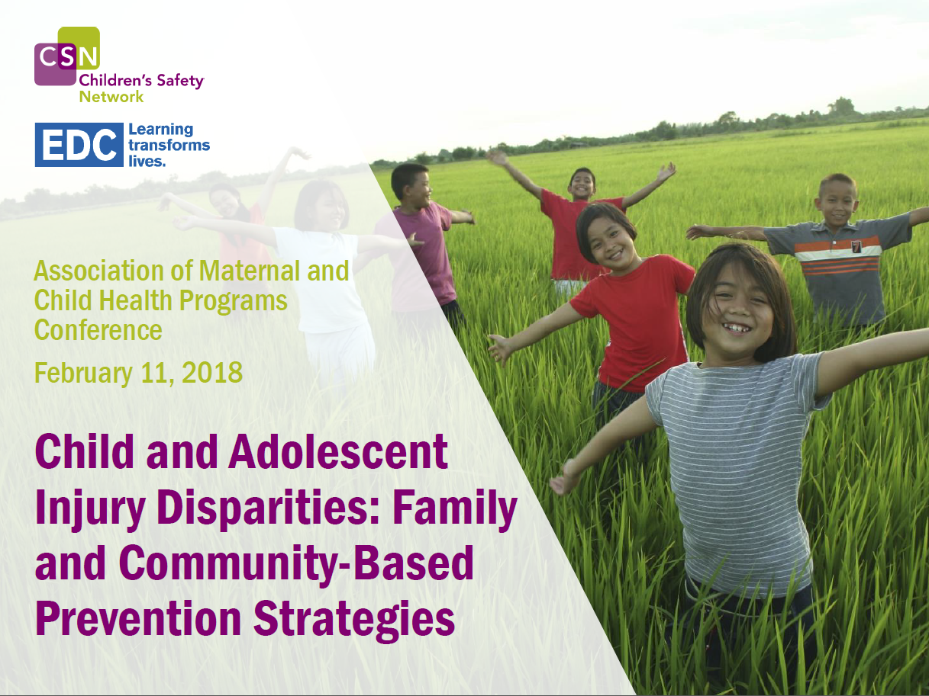

Slide 2

How healthy development should occur in your area of study
In child development, incidents may arise that put the child at the risk of getting injuries and thus threatening their safety.
However, the issue of a child’s safety is only guaranteed when injuries are ceased and a healthy environment is initiated for child development (Kahl, et al., 2007).
Falling has been proven to be the most cause of injury amongst children.

Slide 3
How healthy development should occur in your area of study
To ensure that the child is not exposed to falling, the parents and the caregivers are supposed to check on the environment of the child to ensure that it is safe.
Here, one is required to remove tripping hazards from the floor or the ground that the child is around. Consequently, the caregiver or the parent should ensure that the child is prevented from burns. This is also another major cause of injuries among children.

Slide 4
The challenges that can occur in your area of study
According to Kahl, et al., (2007), at a wider spectrum, the issue of the injury and safety of children has experienced numerous fierce debate on what could be the challenges experienced in ensuring there are safety measures in children to curb injuries. These are
Failure of caregivers or parents in ensuring they protect their children at whatever cost
Negligence or recklessness
Poverty

Slide 5
Recommendations for the prevention of those challenges
The two challenges may be dealt with if the following guidelines are followed;
The parents and the caregivers should ensure that the environment of the child is kept safe by removing anything that may cause injuries to the child such as sharp objects, flammable liquids, and also cords
In the case of unintentional injuries such as the taking of poisonous substances the parent or caregiver should contact poison control or emergency service immediately to avoid the death of children
Better housing and a good environment

Slide 6
Recommendation for ways to address those challenges
In one way or another, parents or caregivers may find themselves at a point where the child has gotten an injury either intentionally or unintentionally. At such a point of occurrence, the caregiver or parent should contact the emergency services immediately, if it is the case of fire or poisoning (Kahl, et al., 2007). This will increase the rate of survival of the child and minimize death occurrence. Besides this, the parents and caregiver should seek immediate intervention either in the hospital to save the child from the impacts of the injury.

Slide 7
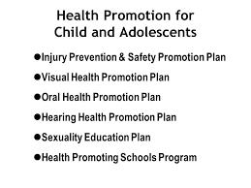

Slide 8
References
Kahl, H., Dortschy, R., & Ellsässer, G. (2007). Injuries among children and adolescents (1-17 years) and implementation of safety measures. Results of the nationwide German Health Interview and Examination Survey for Children and Adolescents (KiGGS). Bundesgesundheitsblatt, Gesundheitsforschung, Gesundheitsschutz, 50(5-6), 718-727.

